Slide 1
Boolean functions
Exercise 7.1
Simplify the following Boolean functions of 4 variables given by their values 1, using Quine’s method.
f₁(1,1,1,1) = f₁ (1,1,0,1) = f₁ (0,1,1,1) = f₁ (1,1,0,0) = f₁ (0,1,0,0) = f₁ (0,0,0,0) = f₁ (0,0,0,1) = f₁ (0,0,1,1) = 1

Slide 2
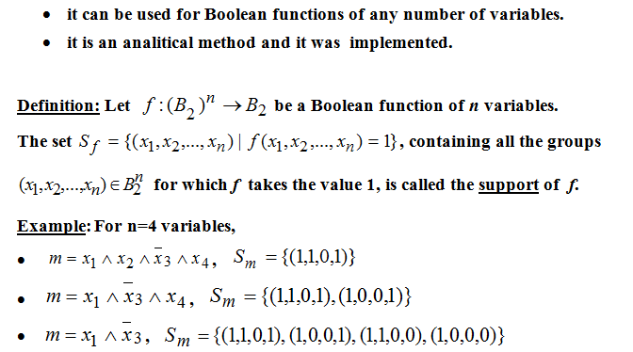
Quine’s Method

Slide 3
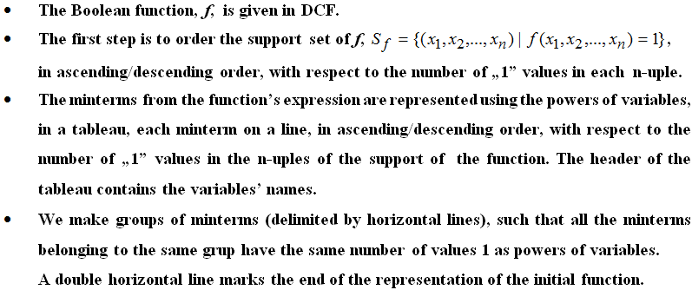

Slide 4
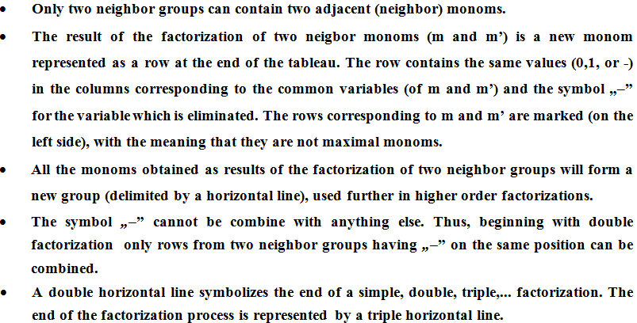

Slide 5
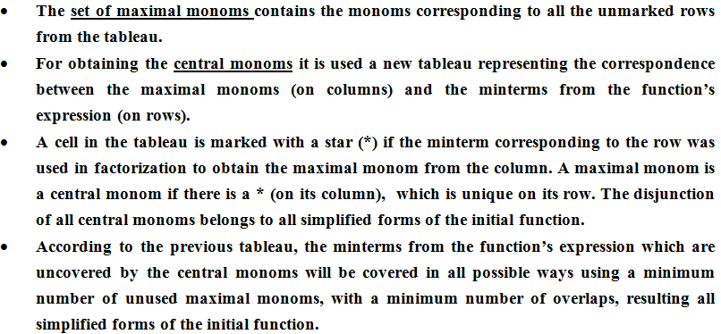

Slide 6

f₁(1,1,1,1) = f₁(1,1,0,1) = f₁(0,1,1,1) = f₁(1,1,0,0) = f₁(0,1,0,0) = f₁(0,0,0,0) = f₁(0,0,0,1) = f₁(0,0,1,1) = 1
We find the support set of the function f and order it with respect to the number of “1” values in each n-uple.
S_{f}={(1,1,1,1), (0,1,1,1), (1,1,0,1 ), (0,0,1,1), (1,1,0,0),(0,0,0,1),(0,1,0,0),(0,0,0,0)}

Slide 7
_{Group} |  | x₁ | x₂ | x₃ | x₄
I | ✓ | 1 | 1 | 1 | 1 | m₁₅
II | ✓ | 0 | 1 | 1 | 1 | m₇
 | ✓ | 1 | 1 | 0 | 1 | m₁₃
III | ✓ | 0 | 0 | 1 | 1 | m₃
 | ✓ | 1 | 1 | 0 | 0 | m₁₂
IV | ✓ | 0 | 0 | 0 | 1 | m₁
 | ✓ | 0 | 1 | 0 | 0 | m₄
V | ✓ | 0 | 0 | 0 | 0 | m₀
VI = I+II |  | - | 1 | 1 | 1 | m₁₅ V m₇ = x₂ x₃ x₄= max₁
 |  | 1 | 1 | - | 1 | m₁₅ V m₁₃ =x₁x₂x₄ = max₂
VII=II+III |  | 0 | - | 1 | 1 | m₇V m₃= x̄₁ x₃ x₄=max₃
 |  | 1 | 1 | 0 | - | m₁₃ V m₁₂ = x₁x₂ x̄₃= max₄
VIII=III+IV |  | 0 | 0 | - | 1 | m₃ V m₁ = x̄₁ x̄₂x₄ = max₅
 |  | - | 1 | 0 | 0 | m₁₂ V m₄ = x₂ x̄₃x̄₄ = max₆
IX = IV + V |  | 0 | 0 | 0 | - | m₁ V m₀ = x̄₁ x̄₂x̄₃ = max₇
 |  | 0 | - | 0 | 0 | m₄ V m₀ = x̄₁ x̄₃x̄₄ = max₈

Slide 8
 | max₁ | max₂ | max₃ | max₄ | max₅ | max₆ | max₇ | max₈
m₁₅ | * | *
m₇ | * |  | *
m₁₃ |  | * |  | *
m₃ |  |  | * |  | *
m₁₂ |  |  |  | * |  | *
m₁ |  |  |  |  | * |  | *
m₄ |  |  |  |  |  | * |  | *
m₀ |  |  |  |  |  |  | * | *
There is no (*) which is unique on a certain row, all the minterms are covered by two maximal monoms.
C(f) = Ø, third case of simplification
f₁^{s}(x₁, x₂, x₃, x₄) = max₂ V max₃ V max₆ V max₇ = x₁x₂x₄ V x̄₁ x₃ x₄ V x₂ x̄₃x̄₄ V x̄₁ x̄₂x̄₃
f₂^{s}(x₁, x₂, x₃, x₄) = max₁ V max₄ V max₅ V max₈ = x₂ x₃ x₄ V x₁x₂ x̄₃ V x̄₁ x̄₂x₄ V x̄₁ x̄₃x̄₄

